Slide 1
BMW Critique Team
Batool Awwad
Doron Rosenberg
Ekaterina Moustafina
Linn Mona
Lisa Moore
Shahrzad Fereiduni
Wiem Azaiez

Slide 2
Agenda
Marketing Mix
SWOT Analysis
Conclusions

Slide 3
Marketing Mix
Product:
Luxury vehicles: cars, motorcycles
1-3-5-6-7 series (from small to large)
M series: sports
X series: SUV
Z series: beemer
Eco-Friendly
Diesel powered versions
Customization (product adaption)
Aggressive product strategy
Offer a wide range of products

Slide 4
Marketing Mix
Price:
High prices for high quality image
Price range: $30,000-$200,000
Varies with customization and size
Different prices in different countries (currency)

Slide 5
Marketing Mix
Promotion:
Standardized communication
Local and Global campaigns
Stimulating demand before production
Trade shows
Sponsorship
Private parties for loyal customers

Slide 6
Marketing Mix
Place:
Manufacture Globally:
Europe: UK, Austria, Germany
USA
South Africa
Manufacturer → Dealer → Customer
Build your own car online

Slide 7
SWOT
Strength:
Strong brand image & equity
Strong production network
Extensive global presence
Strong R&D capabilities
Innovation
We add:
Made in Germany
Product diversity
First mover in virtual ads
Product adaption, communication extension

Slide 8
SWOT
Weakness:
Male dominated
X High advertising expenditures (sales increase?)
X Brand vs. Model Awareness (it is a strategy not a weakness)
Fuel-efficient models
We add:
Maintenance cost is high

Slide 9
SWOT
Opportunities
X Online marketing
Eco-friendly technologies
Asian markets
We add
Global expansion
Growing market segments

Slide 10
SWOT
Threats
Increased competition in luxury automotive market
Economic changes
X Environmental protection regulations
We add:
Change in oil prices
Economic/social issues
Competitors cutting manufacturing cost
Increase use of Online marketing

Slide 11
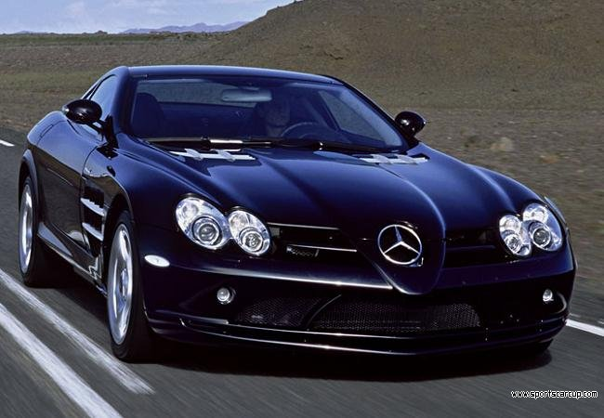
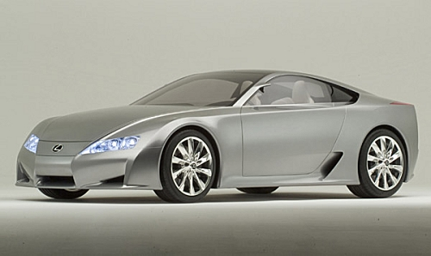
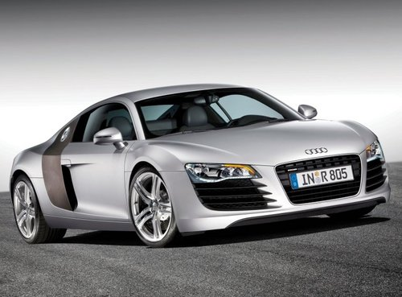
Competition
Mercedes
Lexus
Audi
Notes:
COMPETITIVE ANAYSIS
(1997)Mercedes, Lexus and Audi almost pushed BMW from its leading position in the luxury car segment
BMW 3 biggest competitors have targeted BMW’s greatest strength—performance—
so BMW unable to distinguish itself as having unparalleled standards of quality
MERCEDES
DaimlerChrysler parent company
Global presence
Strong brand
Presence
Product Range
Technology Leadership
Low-key advertising
Has joined the Internet advertising movement
LEXUS
Toyota Motor Sales U.S.A. parent company
America’s top-selling luxury car
Challenge to lose “tough but reliable” Toyota image
Targeting younger buyers
Average age of Lexus owner is 50
Limited only presence—trying to change this somewhat with new ads
AUDI
AUDI Group parent company
Promoting exclusivity of its cars
Ambitious online marketing campaign (during the time of the case)
Aims to educate and entice users to go to dealerships through interactive site and online sweepstakes and prizes

Slide 12
Challenges
Stay on top by being innovative
Localized Advertisement
“Efficient Dynamics Edition”
Convince the American market to buy diesel cars
High environmental standards in Europe

Slide 13
Conclusion
The increased percentage of generation X’ers and dot.comers created the need for a different marketing strategy. However, it also implies that BMW must constantly innovate its campaigns since these particular target audiences quickly view “innovative trends” as ordinary.
Although the cost was high for BMWFilms.com, other media mix must be leveraged in order to promote the films and optimize results
We recommend billboards, periodical publications X and radio.
Also, air the series on Television as an actual series and not as commercials X
The strategy itself should be used globally but the “films” should take different cultures into consideration. To overcome the culture barriers, famous filmmakers from all over the globe were recruited to produce different styles for each episodes. X
With all this success: BMW must not drift away from focusing on model advertisement.
The advertisement targeted male viewers mostly; women are becoming a rising buying force and must not be ignored when advertising.

Slide 14
Marketing Mix
Product:
Luxury vehicles: cars, motorcycles
1-3-5-6-7-8 series (from small to large)
M series: sports
X series: SUV
Z series: beemer
Customization

Slide 15
Questions?
Thank You!

Slide 16
声明：
所有的版权属于原有公司，文件均来自公开渠道
此文件仅供学习使用，任何人不得进行以此为商业目的的行为
如有疑问，请立即删除
学习世界五百强和咨询公司PPT课程请访问如下网站搜索：“司马懿”
百度传课：司马懿PPT学校
https://www.chuanke.com
网易学堂：司马懿PPT学校
https://study.163.com
知乎： 司马懿PPT学校
https://www.zhiu.com

